Slide 1
Animals: Chordates

Slide 2
What is a Chordate?
Characteristics:
Have a clear backbone
Have an Endoskeleton
Regulate body temperature
More advanced brain

Slide 3
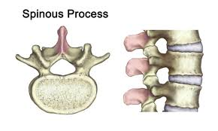
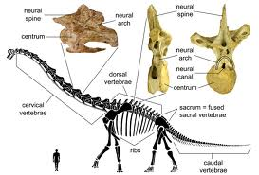
The Backbone
Backbones are made of vertebra
The vertebra protect the spinal cord, which connects the nerves of the body to the brain

Slide 4
Cartilage Vs. Bone
The endoskeleton is made of either cartilage or bone
Cartilage-softer and more flexible
Bone-harder and more rigid

Slide 5
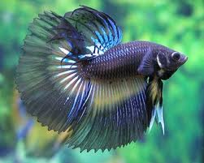
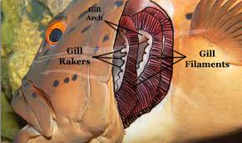
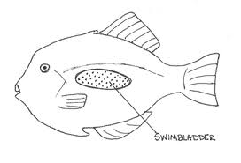
Fishes
A fish is a vertebrate that lives in water and has fins
Pull oxygen out of the water using gills
Use a swim bladder to change their position in the water

Slide 6
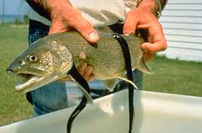
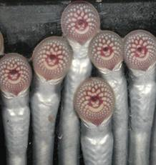
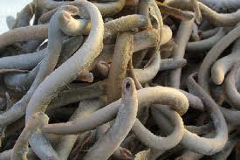
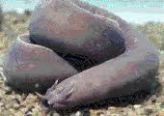
Jawless Fish
Simplest Fish
Do not have a moveable jaw
Skeletons made of cartilage
No scales
Do not have paired fins
Lampreys & Hagfish

Slide 7
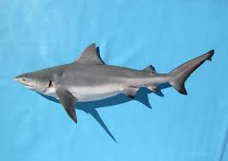
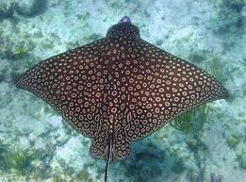
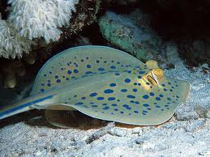
Cartilaginous Fishes
Have jaws, scales and paired fins
Skeleton made of cartilage
Sharks, skates & rays

Slide 8
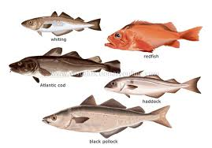
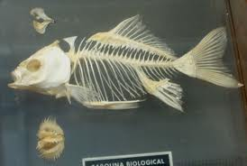
Bony Fishes
Have scales, fins and jaws
Skeleton made of bone
95% of fish species

Slide 10
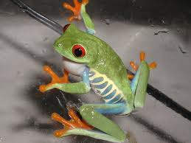
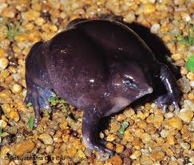
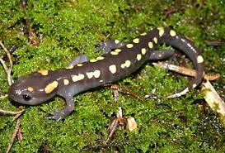
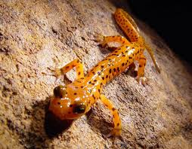
Amphibians
Live part of life in water
Cold-Blooded
4 legs
Lay eggs in water
Metamorphosis-total change in body shape

Slide 11
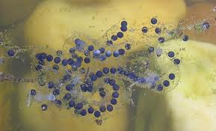
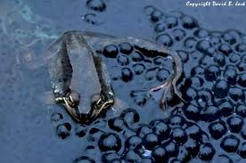
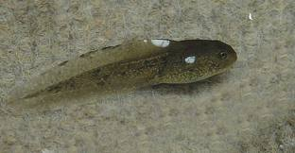
Amphibians
Name means “double life”
Their eggs will dry out and die if laid on land
So most amphibians begin their lives in water
They have gills
No legs
Usually have a tail with fins

Slide 12
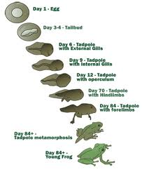
Amphibians
As they grow, baby amphibians develop legs and their gills change to breathe air
These changes let them live on land
Amphibians are the first animals to live most of their lives on land

Slide 13
Amphibians
Have primitive lungs and breathe through their skin
Need to stay moist or they suffocate
Skin must be thin for this to work
Many amphibians are poisonous because they do not have any other protection
Because they depend so much on water, pollution is very dangerous for amphibians

Slide 14
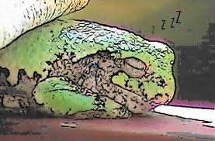
Amphibians
Amphibians are cold-blooded- their body temperature does not go above the temperature of their environment
When it gets too cold or dry, amphibians will hibernate
Hibernation is a special type of sleep that allows organisms to survive conditions that they normally would not
When conditions are better they wake up

Slide 15
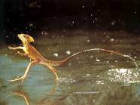
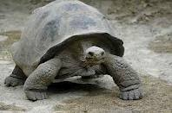
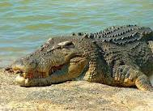
Reptiles
Are ectothermic
Have scales
Have 4 legs
Have toes with claws
Lay eggs with shells

Slide 16
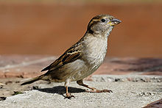
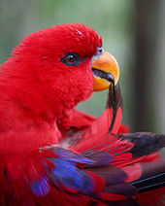
Birds
Are Endothermic
Have feathers
Have 2 Legs
Lay eggs with hard shell

Slide 17
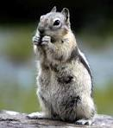
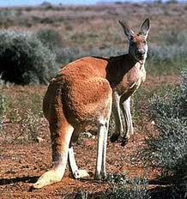
Mammals
Endothermic
Have hair or fur
Give birth to live young
Make milk for young

