Slide 1
Competition, Cooperation & Adaptations

Slide 2
Competition
In ecosystems, several different populations live in the same place at the same time
Each of these populations needs materials from the environment
Food
Water
Shelter

Slide 3
Competition
Organisms in an ecosystem must compete with each other to survive
If an organism does not get enough of the materials it needs, it will die
If an organism dies before it has a chance to reproduce, its genes are not passed on

Slide 4
Competition
Over time, the most successful competitors will survive to reproduce
This causes small changes in the population
These changes are adaptations

Slide 5
Adaptations
An Adaptation is a small change in an organism that helps it survive better in its ecosystem
Examples:
Giraffe’s necks help them reach food
Tigers stripes make them hard to see
Flies eyes help them sense motion

Slide 6
Mutations
Adaptations happen because of mutations
A Mutation is a small change in the DNA of an organism
Since that change is in the DNA it can be passed to offspring

Slide 7
Adaptations
Camouflage organisms blend into their surroundings to make them harder to see
Predators can sneak up on prey more easily
Prey can hide more easily from predators

Slide 8
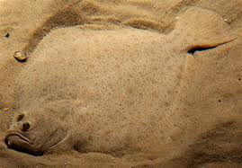
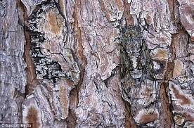
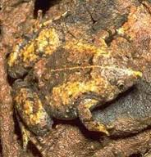
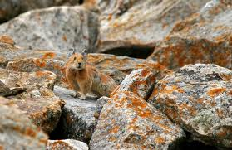
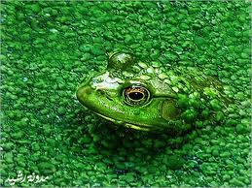
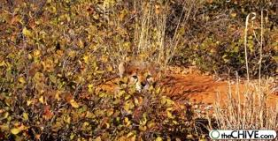
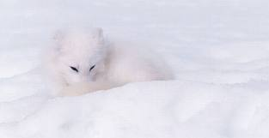
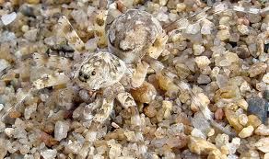

Slide 9
Mimicry
Sometimes organisms will end up looking like something that is dangerous so others will leave them alone

Slide 10
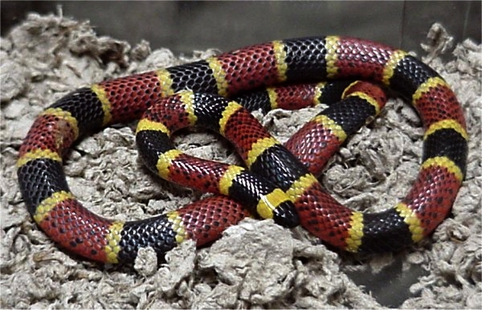
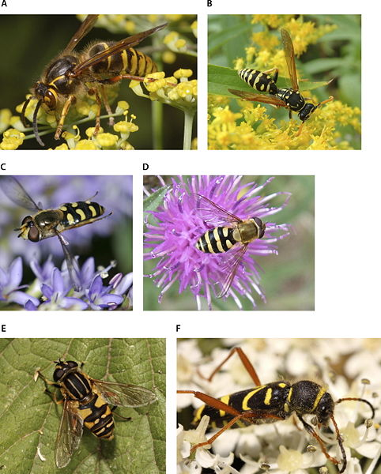
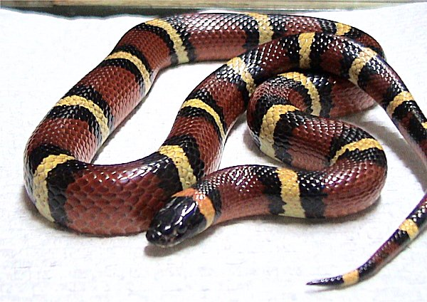

Slide 11
Cooperation
Sometimes organisms will cooperate to help them survive
Herds-large groups of animals can fight off predators
Packs-groups of predators work together to hunt and share the food

Slide 12
Symbiosis
Mutualism-Both species benefit from working together
Commensalism-Neither species benefits or is harmed
Parasitism-One species benefits, one is harmed
Examples?

