Slide 1
Earth Biomes
The wonderful things of Earth.

Slide 2
Ecosystems
An Ecosystem is shaped by:
Food webs
Water, carbon and nitrogen cycles
Weather

Slide 3
What is a Biome?
A Biome is a group of Ecosystems with similar climates and organisms
Climate is driven by the amount of sunlight and rainfall

Slide 4
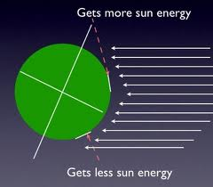
What is a Biome?
The earth is round, so light from the sun hits the earth unevenly
Less light at poles
More light at equator
More light = more energy

Slide 5
Climate
Climate has 2 main parts:
Temperature
Determined by Latitude and Altitude
Rainfall
Determined by Latitude and Altitude
The climate determines what type of organisms can live in an area

Slide 6
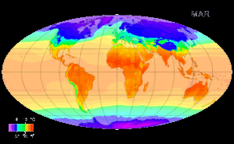
temperature Map

Slide 7
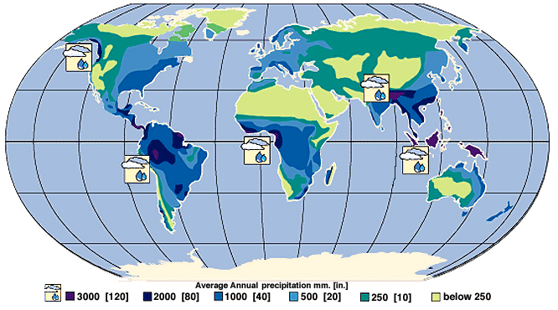
Rainfall map

Slide 8
Plant life
Producers form the base of any ecosystem
Producers have adapted to live almost everywhere on the earth
The types of plants help determine the Biome

Slide 9
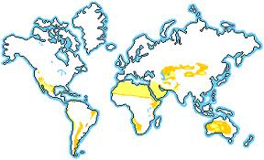
Deserts
Characteristics:
Less than 25 cm of rain per year
Extreme temperature change each day
40○C during the day, 5○C at night

Slide 10
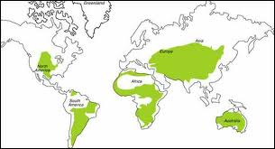
Grasslands
Characteristics:
Grass is primary plant
25-75cm of rain per year

Slide 11
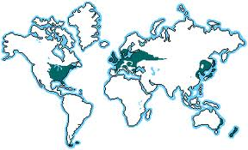
Deciduous Forest
Characteristics:
At least 50cm of rain per year
4 seasons
Trees lose leaves for winter

Slide 12
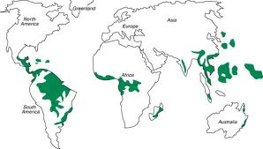
Rainforests
Tropical (warm) or Temperate (cool)
Characteristics:
Highest number of different species
At least 300cm of rain per year

Slide 13
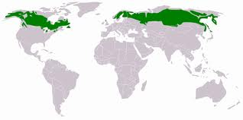
Boreal Forest (taiga)
Characteristics:
20-75cm of rain per year
Cold temperatures
Coniferous trees

Slide 14
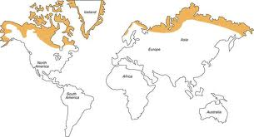
Tundra
Characteristics:
Less than 25cm of rain per year
Very cold
Soil is frozen (permafrost) most of the year

Slide 15
Freshwater
Characteristics:
Ponds, lakes, streams and rivers
Low salt concentration in water
Species adapted to water life

Slide 16
Marine
Characteristics:
High salt concentrations
Oceans, bays etc
5 areas: Estuaries, Intertidal, Neritic, Surface, Deep

